Slide 1
PeopleSoft, Duo, & You
An Applied Discussion on Communications and Security &
Identity and Access Management with Oracle PeopleSoft and Cisco DUO
by Christian Bridge

Slide 2

The 4 Pillars of Identity Access Management (IAM)
Authentication – verifying identities of users, allowing only valid users system access. (Ajish, 2024, pg.7)
Authorization – the extent to which a user can access a system; permissions and roles that grant access to parts of a system.(Ajish, 2024, pg.9)
Administration – Management of user accounts, roles, access and privileges. (Ajish, 2024, Pg. 10)
Auditing, governance, and compliance – Monitoring and recording of access events to detect security threats, enforce compliance, and maintain a record of user activities. (Ajish, 2024, pg.11)

Slide 3
Two Principles of
Communication and Network Security
Layering – designing something in increasingly abstract terms, with each layer offering some aspect of security or assurance.
Domain Separation – Separation of network traffic at collision domains, broadcast domains, and segments in order to avoid network congestion, and adversaries developing understandings of the network topology.
Deane & Kraus, 2021, pg. 284

Slide 4
PeopleSoft
Created by Oracle, PeopleSoft (PS) is a variety of “Oracle Cloud Applications”, or Software as a Service (SaaS).
SaaS are software developed and maintained by a service provider, which provides regular database access and updates via internet, based on a subscription model.
The University of North Texas uses a few PeopleSoft solutions to manage Student Enrollment, Student Finances, Employees & HR, and Student Self-Service.
(Oracle, 2024)

Slide 5
Benefits of SaaS
Lower up-front Costs/Quick-Deployment: Majority of services are hosted off-site, so it does not require as much hardware or IT personnel to start and run.
Data Portability: Since the database is not locally hosted, you can access it from any computer with credentials to the database.
Connected, Cross-Business Solutions: Tying various management systems together so they can communicate and transfer data between each other.
(PeopleBooks, 2024, pg.3)
Ajish (2024, pg. 1-2) adds Cloud applications and platforms have revolutionized the information technology (IT) world by providing a solid foundation for flexible, scalable, and efficient solutions. These services also allows companies to provide consistent updates to software and hardware to counter the increasing number of cloud-based cyberattacks.

Slide 6
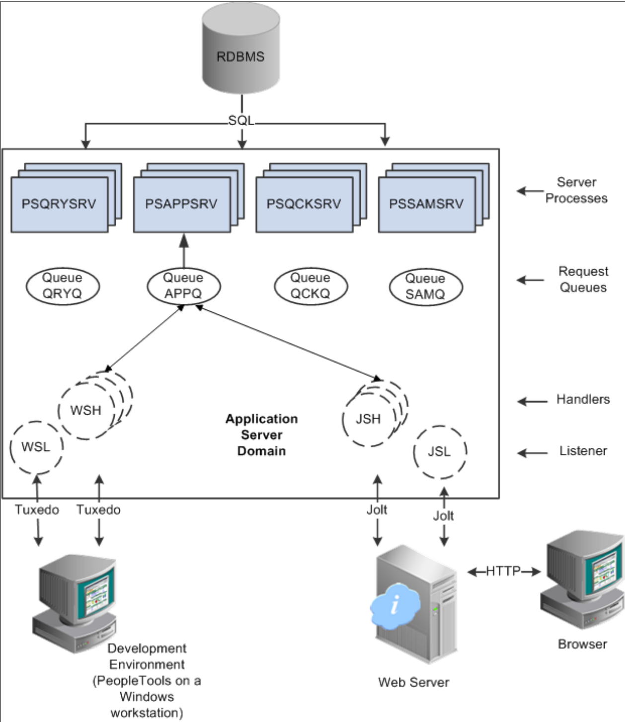
PS Internet Architecture -
Layering & Domain Separation
Although much more complex than needed for our discussion, we can see the many steps taken by a SaaS/Cloud solution for a user to connect to send a request to the database and receive a reply.
The browser connects to the web server, the Web Server to the Application Server, and after queuing the Server Processes the response, and returns the data in reverse to the browser.
(PeopleBooks, 2024, pg.3)

Slide 7
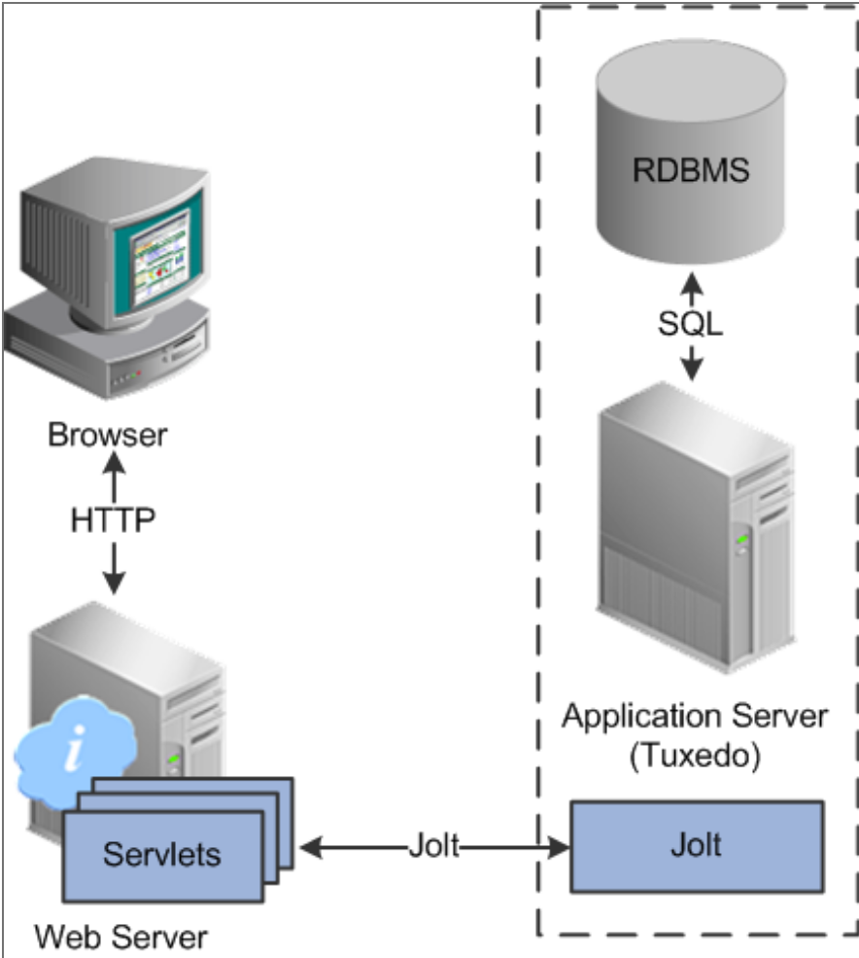
Web Browsers & Servers
Web Browsers send HTTP/S requests to PeopleSoft servlets running on the web server.
The webserver translates the HTTP/S requests into a Jolt Request
PeopleSoft sends HTML, JavaScript, and Cookies to the browser.
After system authentication during sign-on, PeopleTools security deploys a web browser cookies to store a unique access token for each user session.
(PeopleBooks, 2024, pg.3)

Slide 8
PS Authentication & Single Sign-On (SSO)
The use of web browser cookies to store an access token is meant to reauthenticate users and bypass the sign-in process as users navigate the system and even access separate PeopleSoft applications.
The three configurations Oracle offers are:
  PeopleSoft applications – access to multiple PeopleSoft Servers
  PeopleSoft and Oracle applications – Sign in to one system, and access both.
  Desktop – Once signed into a network computer and authenticated with network credentials, the user can freely access all PeopleSoft applications.
(Security Administration. PeopleBooks, 2024, pg. 2)

Slide 9
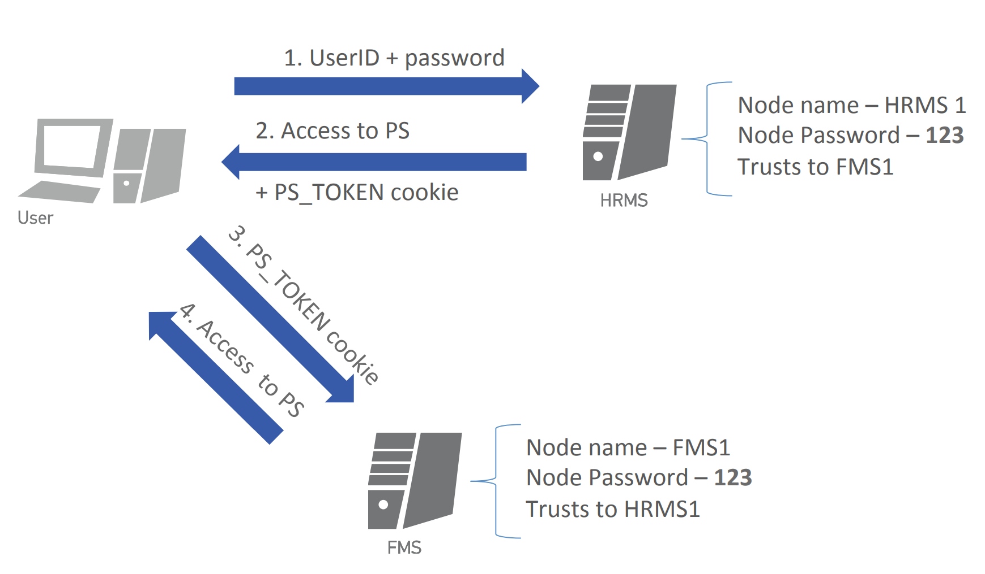
Example of PS SSO & PS_TOKEN
(Tyurin, 2018, Slide 52)

Slide 10
User Profiles & PS_TOKENS
Users have:
  User Profiles: Individualized, but linked to one or more roles, and the roles respective permissions.
  Roles link user profiles to permissions, and usually are used to group a set of pre-determined permissions.
  Permissions control view/read/write access across the system
  (Security Administration, PeopleBooks, 2024, pg.2)
Once a user is authenticated, they receive a PS_TOKEN cookie to their browser.
Security Features:
  Cookie exists in memory; not written to disk
  There is no password stored in the cookie
  Expiration time of a cookie can be set from hours to minutes.
  (PeopleBooks, 2024, pg.10)

Slide 11
Issues with SSO & PS_TOKENS
Lingering Tokens when switching between user profiles, allowing users to see various data points that one profile had access to while another does not.
Possible reverse engineering of a PS_Token understanding the make-up of the token, where only one value, a “pre-shared key” is unknown.
Theoretically this means a bad actor could obtain a PS_TOKEN cookie, obtain necessary values and signatures from token, make offline brute force attacks and comparing results of hash with signature.
(Tyurin, 2018, slide 60)

Slide 12
Zero Trust Architecture (ZTA)
“This model fundamentally shifts the security paradigm by assuming that no network boundary is inherently secure.”
ZTA works using the following principles:
  Continuous verification regardless of user location or resources they seek.
  Limit “blast radius” through compartmentalization and segmentation of resources
  Automate context collection and response incorporating behavioral data like identity, endpoints, and workloads to form a holistic overview for security incident responses.
This model has allowed much further progress post-COVID to allow flexible work arrangements like work-from-home, personal devices, and outside network connections to an internal company network.
(Ajish, 2024, p.3)

Slide 13
ZTA 7 Key Pillars
Identity – Identity management, authentication and authorization.
Device – securing endpoints and managing trust with them.
Network/Environment – Network segmentation and visibility.
Application/Workload – Secure applications, APIs, and workloads.
Data – Protecting sensitive data via classification, encryption, and access control.
Visibility and Analytics – Visibility into their network, devices, and user behavior.
Automation and Orchestration – streamlining security processes and coordinating responses to security incidents.
(Ajish, 2024, pg.4)

Slide 14
Zero Trust Architecture (ZTA) & UNT
These types of attacks mean that many customers of Oracle products can have bugs released by Oracle for the SaaS exploited like the attack type “Tokenchpoken” amongst other internal and external attack vectors. (Tyurin, 2018, slide 68)
For this reason and more, the University of North Texas has transitioned to a Zero Trust Architecture to protect data and enhance security, especially as the university supports work-from-home, contractors, and remote access.

Slide 15

The Cons of Zero Trust
At it’s most basic level, zero trust means every time a user logs in, they will be prompted to verify their identity, regardless of user behaviors, location, or IP.
This means depending on website time-out settings, different environments, and connecting to a secure network in the first place, you might be verifying your identity multiple times per day.
Anecdotally, as a student and employee I can have to verify using MFA over 12 times in a day of work and school.
It is a balance between User Convenience and Security.

Slide 16
IAM Controls -
Lightweight Directory Access Protocol (LDAP)
LDAP – an internet protocol used to access a directory listing. This directory stores user profiles, and authenticating users. This allows for a single, centralized location to manage user profiles ensuring profiles are always synchronized and reduces redundancies. (Security Administration, PeopleBooks, 2024, pg.2)
Ajish (2024, pg.9-10) also discusses how these Role-Based Access Controls like LDAP, are also fertile grounds to be automated, between analyzing user behavior, user activities, and AI there can be Role Mining and Optimizations, automated user deprovisioning, access request automation, Intelligent user profile management, and more!

Slide 17
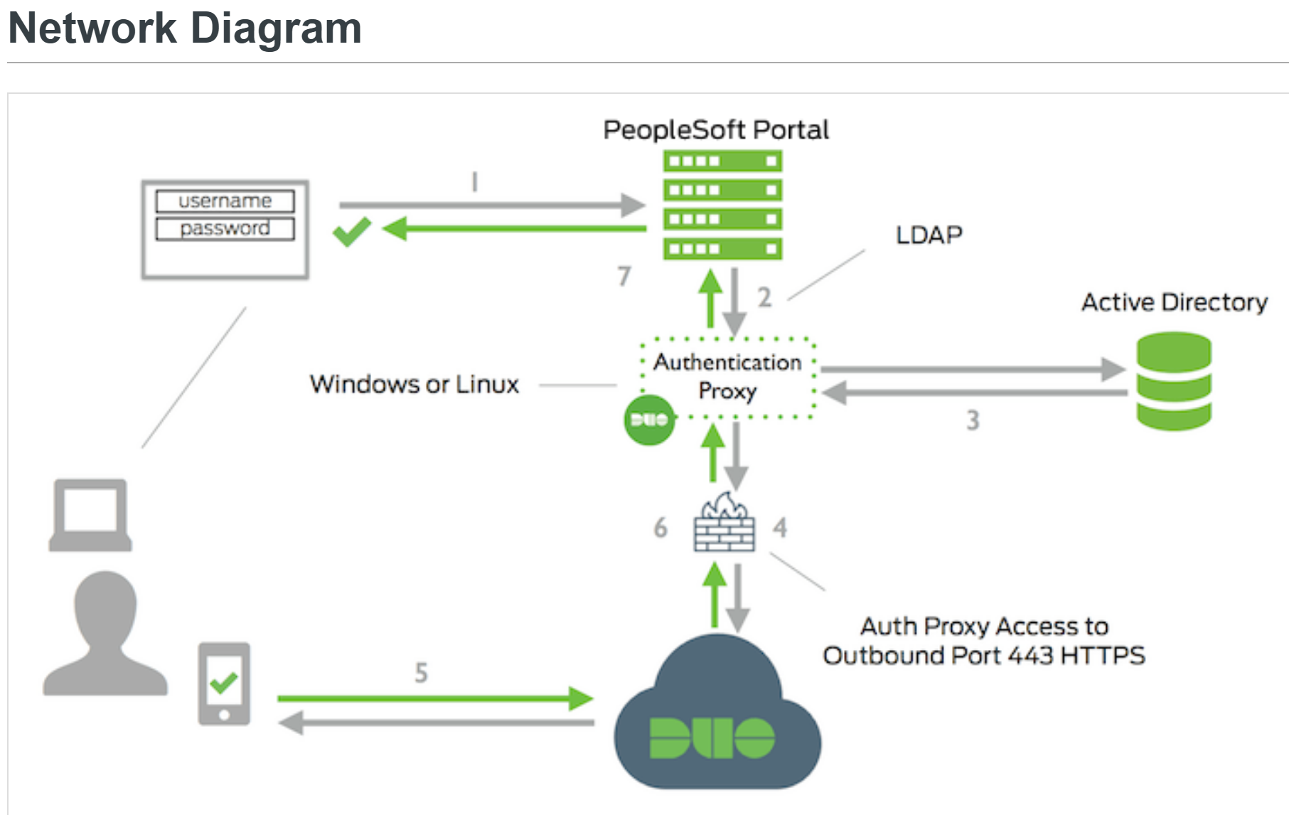
IAM Controls – Multi-Factor Authentication (MFA)
MFA security requires users to initially enter their credentials to a server, and then verify their identity using another method, typically a mobile device or phone. (Duo Security, 2024)
(Cisco Duo, 2024)

Slide 18
Student Perspective
Using user profiles, student accounts can be given basic access for self-service activities like looking at a student account, grades, or enrolling in classes.
Students may log in once a day, or twice a year, depending on their engagement with the PS applications.
User locations can vary across the world as UNT Students can come from anywhere.
User devices can vary widely.
Because these user profiles log-in less, have limited access to the database, and no access to run database wide processes, they could be considered low-risk accounts.

Slide 19
Employee Perspective
Depending on your employment at the university, your access, roles, and permissions will vary widely but these are controlled by assigned user profiles.
These permissions might include view/read/write access to the database, including running batch processes which affect the entire database.
Employees also may have access to Personally Identifiable Information (PII) such as Social Security number, e-mail addresses, location, etc.
Employees are also more likely to log in, depending on their role, and are also required to log into more PS applications which students do not know exist.
Employee devices and networks can vary widely.
These factors would make some employee user profiles high risk.

Slide 20
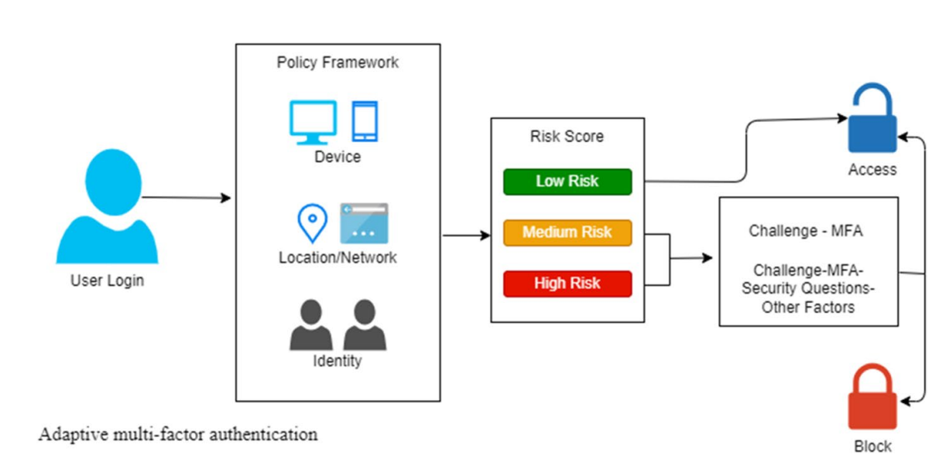
Leveraging AI for MFA
Called Adaptive MFA (AMFA) dynamic implementation of MFA which establishes baseline user profiles based on:
  Device Profile – The system originating the request
  Location – Using IP addresses to filter traffic by IP or locations
  User Behavior – Used to create a baseline of activity for a user profile, and helps in defining a user’s risk level.
  Risk – based on previous features, there account would be deemed as either low-risk, medium-risk, or high-risk
Using the above features, users are assessed for risk level of an account, and can be allowed either SSO, MFA, or more rigorous authentication.
Ajish, 2024, Pg.13

Slide 21
AMFA & ZTA
Ajish (2024, pg.14) argues that AFMA strengthens ZTA by allowing for:
  Contextual Verification – device profiles, location awareness, and user behavior.
  Risk-Based authentication – based on risk, adjust user sign-in requirements.
  Biometric and Token Authentication – Enhance security.
  Location-agnostic Access – Users can connect from any network and be verified by AMFA.
  Scalability and Cloud Readiness

Slide 22
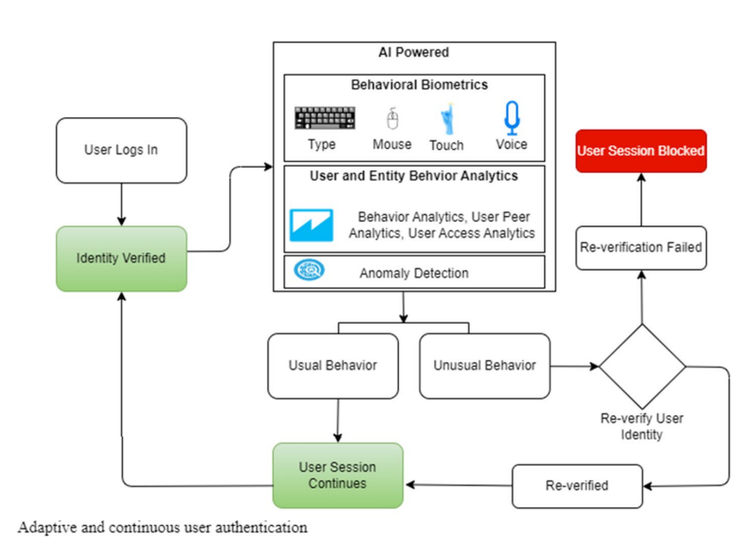
Continuous User Authentication
Another use case of AI beyond AMFA would be using user profiles and user behaviors to detect anomalies or unusual behaviors which would prompt another verification check. (Ajish, 2024, pg. 7-8)
This means that even if a bad-actor could get access to a student account and spoof their token, that subsequent suspicious activity like mass-downloading files could flag the account for another verification check.

Slide 23
Intelligent User Profile Management
& Access Reviews
With all the various job titles, departments, and divisions, in a company it can become extremely granular the amount of management that goes into processing security requests and user profiles.
With AI it is possible to monitor and track user activities which could assist in de/provisioning or changing User Profile permissions. (Ajish, 2024, pg.11)
Hypothetically, a company could use unsupervised machine learning to identify commonalities in user profiles in order to consolidate roles and permissions ensuring less manual management.

Slide 24
Leveraging AI for IAM &
Network Security and Communication
While AMFA is just a small piece of the larger security problems, AI is able to help in the following as well:
  Voice, Speech, or Facial recognition
  Role Creation & Permission Assignments
  Continuous Role Review
  Continuous Compliance Monitoring
  Automated Audit Trail Generation
  Anomaly Detection
  Zero Trust Network Access (pg. 16)
  And much, much more!
  (Ajish, 2024, pg. 7-13)

Slide 25
References
Deane, A.J. & Kraus, A. (2021). Domain 8: Software Development Security (p. 594-624), Official (ISC)² Guide to the CISSP CBK, Sixth Edition, Wiley.
Ajish, D. The significance of artificial intelligence in zero trust technologies: a comprehensive review. Journal of Electrical Systems and Inf Technol 11, 30 (2024). https://doi.org/10.1186/s43067-024-00155-z
Learn about SAAS. Oracle. (2024). https://www.oracle.com/applications/what-is-saas/
System and Server Administration. PeopleBooks 8.51. (2024). https://docs.oracle.com/cd/E24150_01/pt851h2/eng/psbooks/tsvt/chapter.htm?File=tsvt%2Fhtm%2Ftsvt03.htm. Page 3-10
Security Administration. PeopleBooks 8.51. (2024). https://docs.oracle.com/cd/E24150_01/pt851h2/eng/psbooks/tsec/book.htm. Page 2.
Tyurin, A. Oracle Peoplesoft Applications Are Under Attacks! (2018) https://web.archive.org/web/20181118151138/https://erpscan.com/wp-content/uploads/presentations/2015-Hack-In-Paris-Oracle-PeopleSoft-applications-are-under-attacks.pdf. Slides 1-72

Slide 26
References
What is Two-factor authentication?. Guide to Two-Factor Authentication · Duo Security. (2024). https://guide.duo.com/
Duo Two-Factor Authentication for PeopleSoft. Cisco Duo. (2024). https://duo.com/docs/peoplesoft

